Slide 1
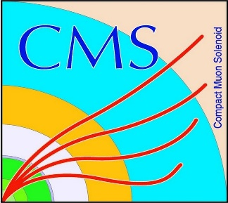

HEP Weekly Report
George Bakas
NTUA

Slide 2
Progress Report
DCS
dbEditorAndNavigator in fwInstallationUtils component
Improvements to the component
Some Batch files used for installation of service projects using the installation db did not work
Redundancy task
Analysis
Theoretical top anti-top pair spin correlation in fully hadronic decay
Finally production with data (how to use CMSSW, crab etc)
Will produce a flatTree that will have just 5 variables
Particle Id, Mass, P_{T}, phi, eta
By identifying the particle from the beginning and the whole top anti-top pair processes → see spin correlation from angular distributions

